Slide 1
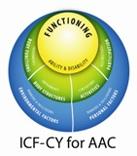

Developing AAC Educational Goals With The Web-Based Communication Supports Inventory-CY
Oregon Health & Science University
Charity Rowland
Melanie Fried-Oken
Sandra M. Steiner
Don Lollar
Assistive Technology Collaborations
Gayl Bowser

Slide 2
Goals today
Present a description of the ICF-CY
Present a description of the instrument
Go through a guided completion of
the CSI-CY
Discuss research findings and the usefulness of the CSI-CY for AAC goal development

Slide 3
The problem
What does
ICD-9: 758.0
mean?

Slide 4
Problem: Knowledge of health condition alone does not predict child’s functional communication or intervention
Individuals with complex communication needs may have difficulty communicating related to a variety of different health conditions
Identifying the health condition alone may not suggest the appropriate intervention
The individual’s functional capacity in different environments + knowledge of the health condition suggests appropriate interventions

Slide 5

A Solution: The ICF
ICF: International Classification of Functioning, Disability and Health (Child & Youth version)
Developed by the World Health Organization (WHO) to complement the ICD (International Classification of Disease)
Designed to describe the functional status of individuals in a standardized manner

Slide 6
Why use the ICF?
Provides a systematic coding scheme to describe a child’s function and intervention needs.
Complements ICD diagnostic coding, focusing on function, instead of etiology or diagnosis.
Establishes a common language for professionals, PWD, family members & the public worldwide that can be used across education, medical and social services.
Provides a scientific basis for understanding and studying health status and outcomes

Slide 7
ICF Concepts
Body doesn’t function properly
Personal activities are limited
Participation in life situations is restricted
Environment affects all dimensions of functioning
There are facilitators and barriers in every environment that affect participation
Notes:
Now, having heard the aims of the ICIDH-2 in some detail, the take home message for ICIDH in simple terms is:
Your body doesn’t function properly
You are limited in your activities
You face barriers in society

Slide 8
An Example: Complex communication needs of one child with Down Syndrome ICD-9: 758.0
Participation D7504.2--Informal relationships with peers: Moderate difficulty
Participation D820.3--School education: Severe difficulty
Body Function B320.4--Articulation: Complete impairment
Body Structure S3203.3--Tongue: Severe impairment
Activity D330.3 Speaking--Severe difficulty
Activity D3501.3 Sustaining a conversation--Severe difficulty
Environment E420.+2--Friends: Moderate facilitator

Slide 9
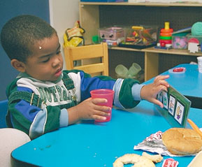
The ICF and AAC
The ICF works especially well for AAC learners, because it separates speech functions from communication functions
Communication ≠ Speech

Slide 10
The Challenge
There is no standard developmental set of skills that can guide AAC goal development.

Slide 11

One Solution: The ICF-CY

Slide 12
The ICF and AAC
The ICF works especially well for AAC learners, because it separates speech functions from communication functions
Communication ≠ Speech

Slide 13
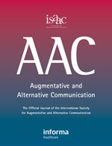
“The ICF fits our international AAC community like an old shoe that we have been wearing for many years.” Fried-Oken and Granlund (2012)
Volume 28, Number 1 (March 2012) Special Issue: AAC and ICF: A Good Fit to Emphasize Outcomes

Slide 14
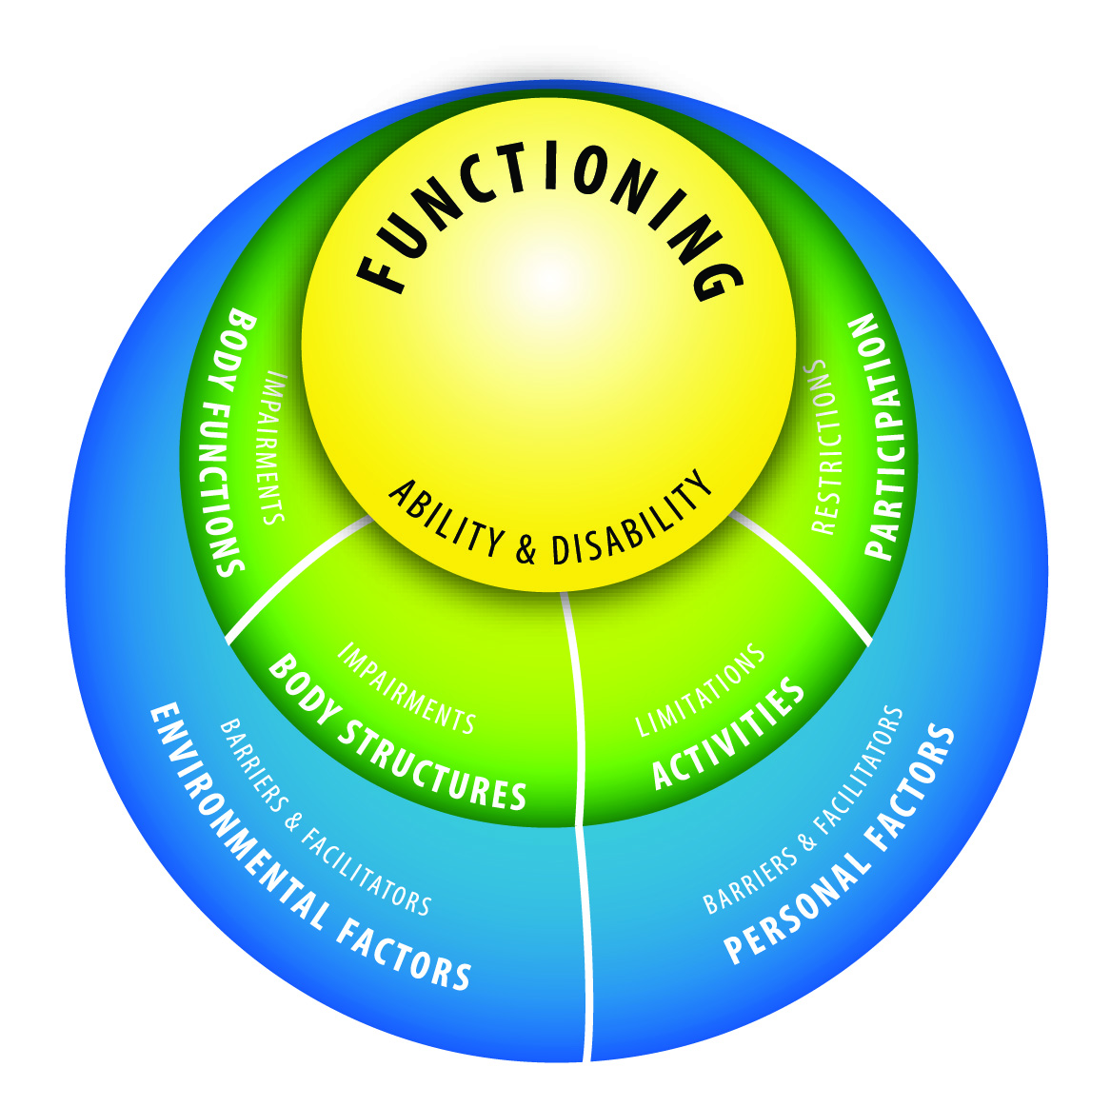
From WHO document to CSI-CY Profile
On-line interactive
CSI-CY Inventory
Published manual of codes

Slide 15
Using the ICF as an Organizational Framework to Improve Communication Goals for AAC Users
Population: School-aged children (in U.S.) who use AAC or are candidates for AAC
Goal 1: Develop and evaluate the CSI-CY to describe communication strengths and needs of children who use AAC
Goal 2: Use the CSI-CY to guide communication goal development

Slide 16
Two-part CSI-CY
Code Set surveys:
participation restrictions,
communication limitations,
functional reasons for them,
environmental facilitators and barriers
Report: prioritizes identified items to facilitate IEP goal development process

Slide 17
Current Version
112 items in 14 sections
Plus 1 open-ended text box for each of 14 sections
Total items = 126
The ICF-CY codes are listed next to each item

Slide 18
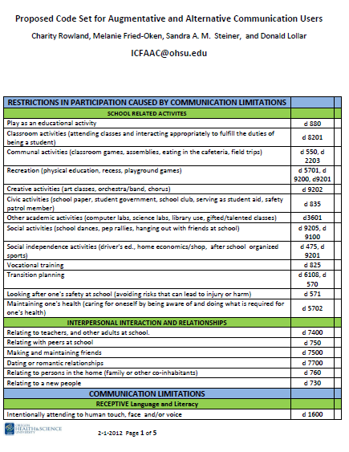
Download the
CSI-CY
Code Set:
www.icfcy.org/aac
(ATIA handout)

Slide 19
Participation Restrictions:
School-related Activities
Interpersonal Relationships

Slide 20
Communication Limitations: Rate limitations in…
Receptive Language and Literacy
Expressive Language and Literacy
Functions of Communication
Rules of Social Interaction in Conversation
AAC: Receptive Communication
AAC: Expressive Modes and Strategies
AAC: Motor Access

Slide 21
Body Functions: Rate impairments that limit communication…
Respiratory
Intellectual
Gross and Fine Motor
Hearing
Vision
Touch
Oral Motor

Slide 22
Environmental Barriers and Facilitators*
Physical environment
Assistive technology
People
Services and policies
*This often corresponds to the special education and related services and supplementary aids and services sections of the IEP.

Slide 23
Final output: Profile Report

Slide 24
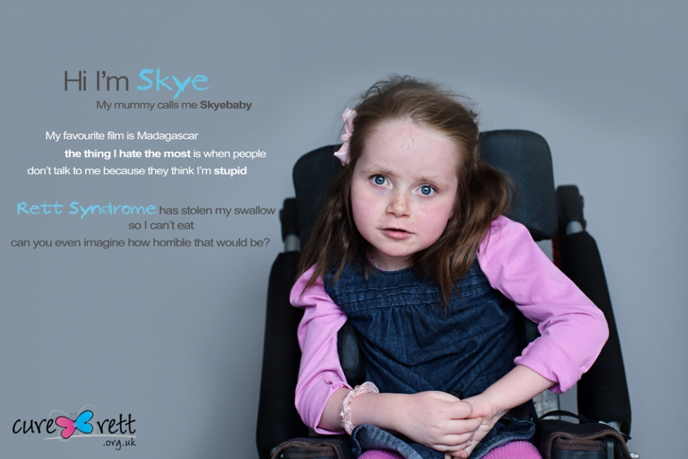
Take a trip with us through the CSI-CY Let’s describe Nicole, a 6 year old girl with Rett Syndrome….

Slide 25
Meet: Nicole Age: 6 years Medical Diagnosis: Rett Syndrome
CURRENT COMMUNICATION IMPAIRMENT
Profound expressive and receptive communication impairment
BACKGROUND INFORMATION
Personal/Social: Nicole was born prematurely and was diagnosed with Rett Syndrome at the age of two years. Due to this neurodevelopmental condition, she has orthopedic impairments, constant hand wringing, inability to speak, and digestive issues. She has received speech therapy for three years and recently received a Tango speech generating device, which she brings to school. She is non-ambulatory and non-verbal, but definitely can get her needs met by vocalizing with laughter, protests, crying, smiles, and eye contact. She presents as a happy child who loves attention. She enjoys human contact and only complains when she is in discomfort.

Slide 26
Let’s complete the CSI-CY together
www.icfcy.org

Slide 27

Research Studies

Slide 28
What is the relationship between items prioritized on CSI-CY and goals on pre-existing IEPs?
Do IEPs include goals that relate to items in the CSI-CY subsections?
Do the items prioritized in the CSI-CY also appear as IEP goals for the student?

Slide 29
Who participated?
N = 35 SLPs and Special Educators (40% SE; 54% SLP; 6% other)
From 15 states
Work settings: Elementary (34%), Middle School (29%), Secondary (37%)
Knowledge of AAC: Expert/Great deal (33%), Moderate (58%), Little (7%)
Disability of targeted students: autism (31%), CP (20%), intellectual disability (17%), other (31%)

Slide 30
IEP data
Great variety in the 35 IEPs
#Goals & objectives per IEP:
Mean = 9.2; range= 1-20
#Accommodations/Services per IEP:
M= 3.7; range= 1-11

Slide 31
What’s missing from the current IEPs?
These CSI-CY subsections were prioritized BUT had no or few IEP goals:
Rules for social interaction
AAC- Motor
Body functions*
Environment: People
Environment: Services and policies*
* May be difficult to address in IEPs.

Slide 32
What overlaps are there in IEP goals and CSI-CY priorities?
CSI-Subsection | % participants who prioritized subsection and included IEP goals
School Activities | 31%
Interpersonal Relationships | 14%
Receptive Language & Literacy | 31%
Expressive Language & Literacy | 26%
Functions of Language | 40%
AAC-Receptive Language & Literacy | 11%
AAC-Expressive Language & Literacy | 40%
Environment/AT | 40%

Slide 33
Data Interpretation
Some prioritized CSI-CY items do appear as goals in many IEPs.
There are ICF constructs that do not appear in IEP goals.
There is great variability in goal development for children who rely on AAC.

Slide 34
Does the CSI-CY Influence Development of Subsequent IEP goals?
Does use of the CSI-CY affect goal development?
Will we see a difference in goals if SE/SLPs complete the CSI-CY before an IEP meeting?
Do SLPs and SEs report that using the CSI-CY helps with goal development?

Slide 35
Methods
61 SLPs and Special Educators (69% SE; 30% SLP)
Experimental group (N=36): Complete the CSI-CY before attending an IEP meeting
Control group (N=25): ‘Business as usual.’
All participants : Send the completed new IEP after meeting.
Outcome: Ratings of IEP goals developed with vs without use of CSI-CY

Slide 36
Data Sources
Coders were blinded to whether the IEP came from the experimental or control groups.
From each IEP, all communication-related goals & objectives, accommodations, modifications and services were extracted.
Each item was coded with the 14 CSI-CY subsections.
The # of CSI-CY subsections addressed per IEP was calculated.

Slide 37
IEP data
Great variety in the 35 IEPs
#Goals & objectives per IEP:
Mean = 8.7; range= 1-22
#Accommodations/Services per IEP:
M= 6.3; range= 1-15

Slide 38
IEP trends: Goals that appeared in IEPs more after CSI-CY completion
Subsection | Control IEPs (no CSI-CY use) | Experimental IEPs (after CSI-CY use)
School Activities | 35% | 47%
Interpersonal Relationships | 23% | 33%
Receptive Lang & Literacy | 65% | 75%
Expressive Lang & Literacy | 77% | 83%
Functions of Language | 77% | 94%
AAC-Motor | 0% | 6%

Slide 39
Data Interpretation
An attitude shift? It’s reinforcing to see that the participation subsections increased in IEPs. We need to stress function and integration of AAC, not just learning to use the device.
The neurotypical language and function subsections increased for AAC IEPs. Perhaps the IEPs are reflecting the importance of language foundation, and how to apply developmental language and literacy skills to device use for AAC implementation.

Slide 40
Future Options
Codify the iterative PROCESS that we have developed for use by other groups to generate code sets for a specific health condition or functional problem
Apply the AAC codes to electronic medical records
Develop a parent version of Profile that could be used to mediate conflicts between home/school

Slide 41

AAC Volume 28, Number 1 (March 2012) Special Issue: AAC and ICF: A Good Fit to Emphasize Outcomes
Rowland, C., Fried-Oken, M., Steiner, S.A.M., Lollar, D., Phelps, R., Simeonsson, R.
and Granlund, M. Developing the ICY-CY for AAC Profile and code set for children who rely on AAC.
Murphy, J. and Boa, S. Using the WHO-ICF with Talking Mats as a goal setting tool.
Raghavendra, P., Olsson, C., Sampson, J., McInerny, R. and Connell, T. School participation and social networks of children with complex communication needs, physical disabilities and typically developing peers.
Clarke, M. T., Petrides, K. V., Griffiths, T., Lysley, A. and Price, K. An examination of relations between participation, communication and age in children with complex communication needs.
Granlund, M., and Pless, M. Implementation of the International Classification of Functioning, Disability and Health (ICF/ICF-CY) and how this relates to Augmentative and Alternative Communication.
Simeonsson, R., Bjork-Akesson, E. and Lollar, D. Communication, disability and the ICF-CY.

Slide 42


www.icfcy.org/aac
Our team
Code Set
Reference list
Publications
Presentations
Funded by:
The Institute of Education Sciences U. S. Dept. of Education Grant #R324A090028 Charity Rowland, PI

